Slide 1
The Silent Shift: How Declining Fertility Is Reshaping Society, Politics, and Migration
From empty classrooms and aging populations to immigration pipelines and mental health strain, low birth rates are quietly rewriting the structure of modern life.

Slide 2
What is your focus area?
This project investigates the ripple effects of falling fertility rates across global societies. While many countries face economic consequences like labor shortages and shrinking tax bases, the social and political impacts are just as urgent and far-reaching.
The analysis focuses on how low fertility is connected to:
Intergenerational tensions and the risk of political instability, as younger populations shrink and struggle to support a growing elderly population.
Transformations in family structures, with fewer children per household and rising rates of social isolation.
School system challenges, where fewer births mean smaller enrollments, reduced funding, and school closures pushing the burden to local governments.
Mental health trends, as societal shifts in identity, purpose, and connection affect emotional well-being across age groups.
U.S. immigration policy, particularly the Diversity Visa Lottery, which becomes a demographic solution importing youth and labor from high-fertility nations.
Together, these factors paint a picture of a world quietly but profoundly changed by one statistic: how many children we’re having or not having.

Slide 3
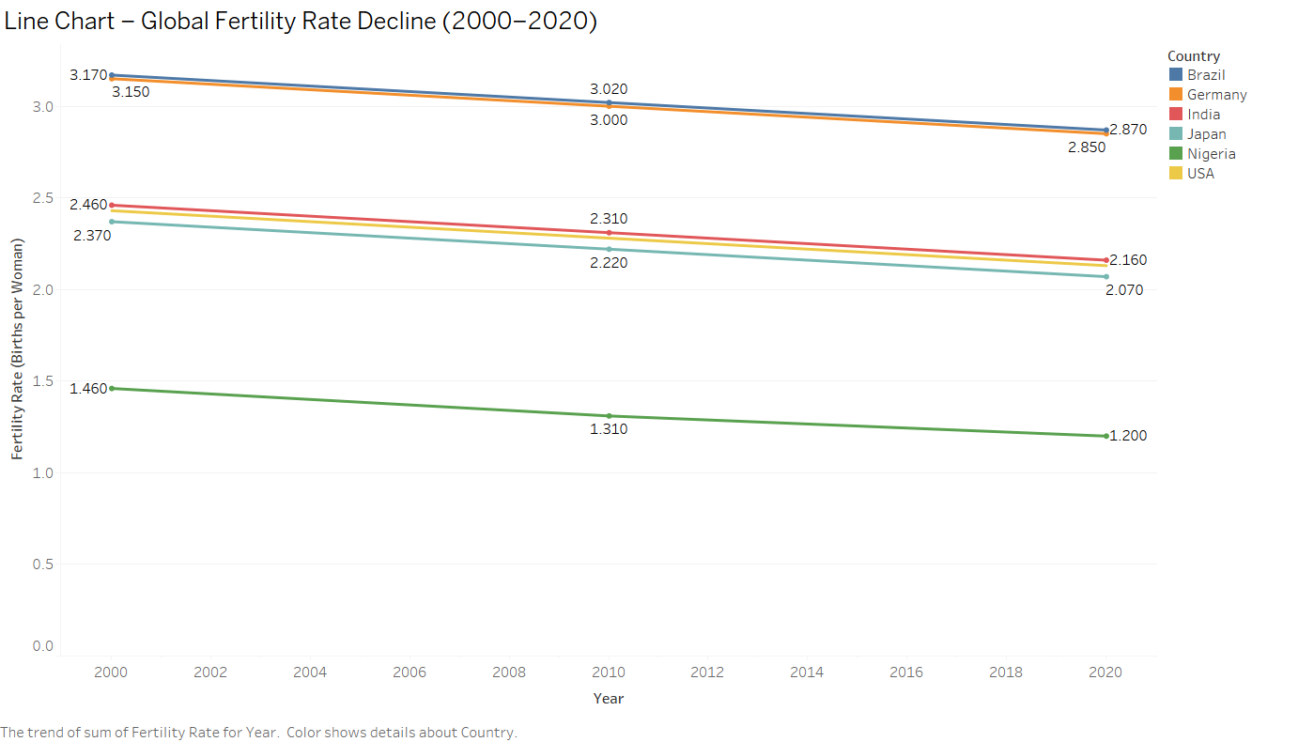
The Long Decline: Global Fertility Rates Fall from 2000 to 2020
This line chart shows the fertility rate trends from 2000 to 2020 across six countries. Each line represents one country’s average number of births per woman over time.
Replace this box with your visualization.
Feel free to resize/move this box
Feel free to add “hand-drawn” annotations to the visualization
Across all countries including both developed and developing fertility rates have consistently declined over the past two decades. Even nations with historically high birth rates like Nigeria and India are experiencing this trend. This global convergence suggests a systemic demographic shift with broad implications for education, labor, and economic sustainability.
The decline in fertility isn’t just a number it signals shrinking future populations, strained pension systems, and the need for new policies around immigration, automation, and caregiving. Understanding this early warning sign is key to preparing for the next 20 years of societal transformation.

Slide 4
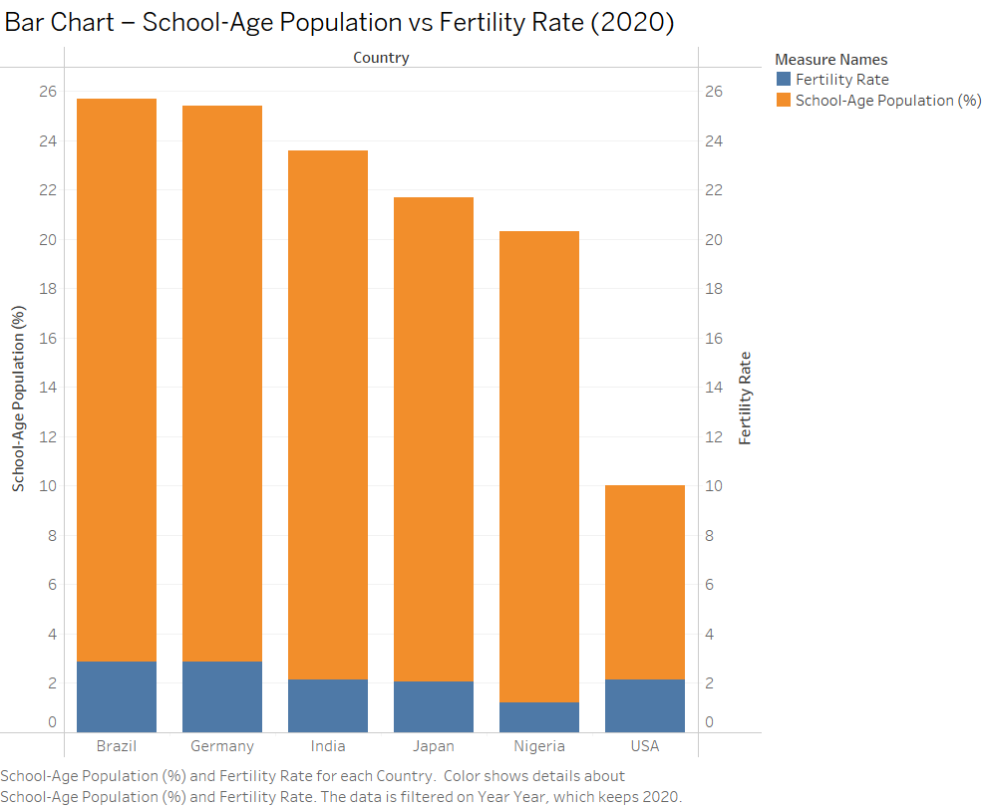
Vanishing Classrooms: School-Age Populations Shrink as Fertility Falls (2020)
This dual bar chart compares each country’s fertility rate to its school-age population share in 2020. Countries like the U.S., Japan, and Germany show both low fertility and a smaller share of youth, signaling a sharp decline in future school enrollments.
Replace this box with your visualization.
Feel free to resize/move this box
Feel free to add “hand-drawn” annotations to the visualization
The connection is direct and undeniable: fewer births mean fewer students, which ultimately leads to smaller schools, reduced budgets, and staff reductions. This isn’t a distant future scenario it’s already happening in countries like Japan, Germany, and the United States, where school districts are merging, closing, or struggling to justify their operating costs. What was once called the “youth bulge” has, in many places, reversed into a “youth drought.” This shift will not only impact education systems it will also affect real estate, local economies, and the future availability of talent for the workforce.

Slide 5
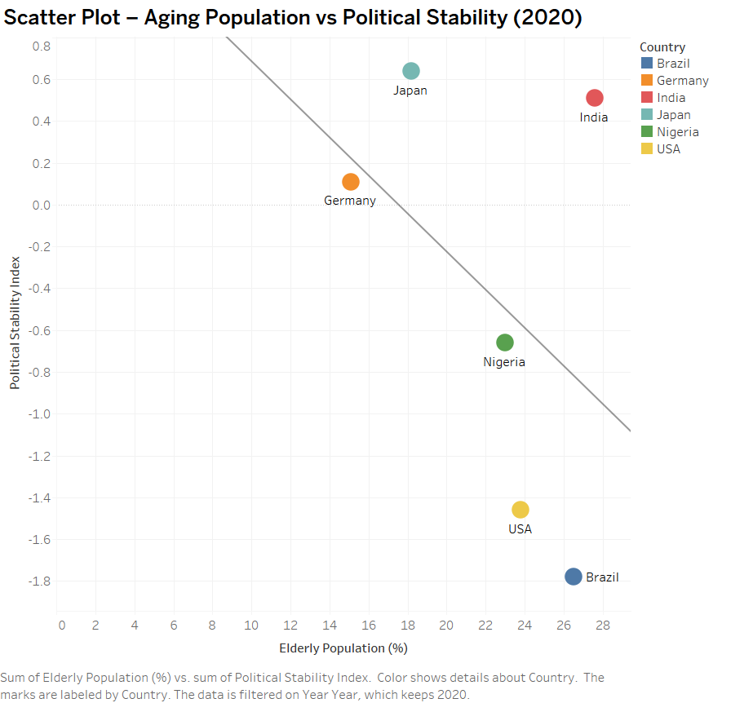
The Age of Instability? Exploring the Link Between Aging Populations and Political Tension (2020)
This scatter plot compares each country’s elderly population share to its political stability index in 2020. It suggests a subtle but important pattern: nations with older populations, like the U.S. and Brazil, may be less politically stable than peers like Japan, which has managed aging more smoothly.
Replace this box with your visualization.
Feel free to resize/move this box
Feel free to add “hand-drawn” annotations to the visualization
As birth rates fall and generations age, political systems face new stressors from budget battles over pensions to clashes in generational values. This visual hints at a deeper story: when young people are outnumbered, democratic energy can fade, and intergenerational tension may rise. Aging alone doesn’t cause instability but it may be the fuel for larger political shifts.

Slide 6
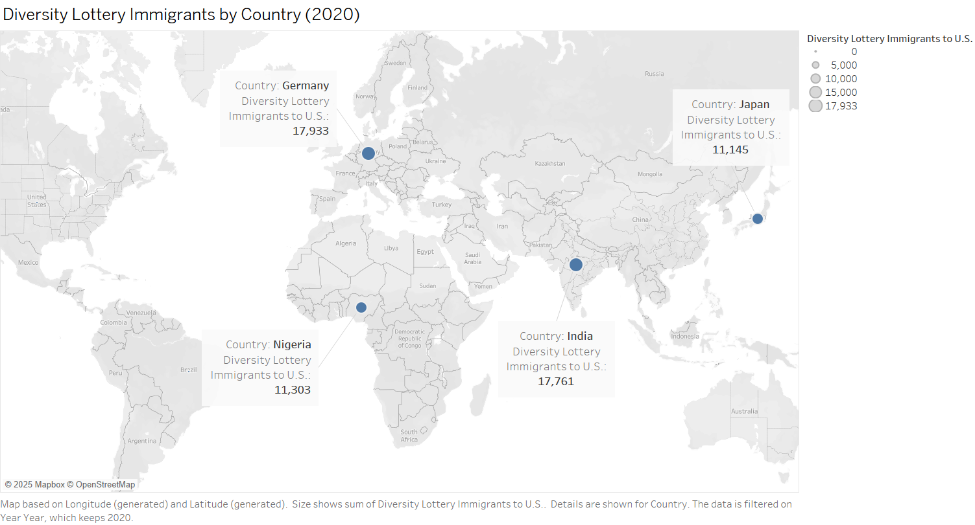
A Lifeline Through Immigration: Diversity Lottery Entrants by Country (2020)
This map shows how many individuals from each country entered the United States through the Diversity Visa Lottery program in 2020. Notably, high-fertility nations like India and Nigeria, as well as low-fertility countries like Germany and Japan, all appear as major contributors.
Replace this box with your visualization.
Feel free to resize/move this box
Feel free to add “hand-drawn” annotations to the visualization
Countries like India and Nigeria, with their still-growing populations, represent a steady source of young, working-age immigrants. But the inclusion of Germany and Japan nations with some of the lowest fertility rates and oldest populations reveals something deeper even aging nations are exporting people as economic opportunity shifts.
In a world where some countries are running out of people, and others have too few opportunities for their growing youth, immigration becomes a bridge economically, socially, and demographically.
The Diversity Lottery may be one of the least-discussed mechanisms by which the U.S. offsets its population decline, sustains school systems, fills labor shortages, and even shapes future voter demographics.

Slide 7
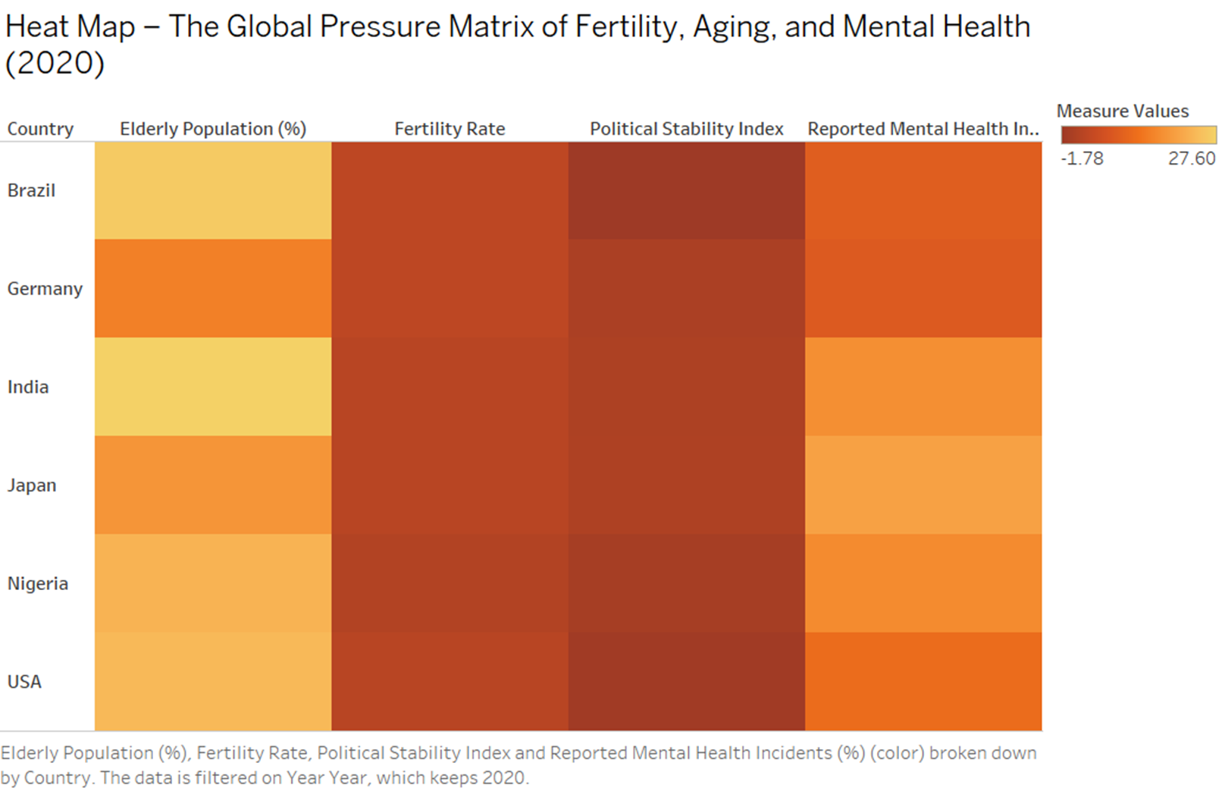
The Global Pressure Matrix: Fertility, Aging, Mental Health, and Instability (2020)
This heat map compares six countries across four major indicators of demographic and societal stress: Elderly Population (%), Fertility Rate, Political Stability, and Reported Mental Health Incidents (%). Darker shades reflect greater pressure or concern across each dimension.
Replace this box with your visualization.
Feel free to resize/move this box
Feel free to add “hand-drawn” annotations to the visualization
When viewed together, these indicators create a multi-layered view of societal strain. Countries like the USA, Germany, and Japan face a dangerous cocktail of aging populations, low fertility, rising mental health concerns, and in some cases, weakened political stability. Meanwhile, even countries like India and Nigeria, though younger, are not immune to emotional and social stressors. The takeaway: Fertility decline doesn't act alone it sets off a chain reaction that ripples through public health, governance, and the fabric of society.

Slide 8
Conclusion: A Future Shaped by Fewer Births and Growing Consequences
Declining fertility rates are no longer just a demographic trend they are a global disruptor.
Through the lens of these visualizations, we explored how this one shift influences multiple systems:
Education systems are shrinking as school-age populations decline.
Aging societies are straining pension systems and increasing dependency ratios.
Mental health challenges are rising, tied to isolation and changing family structures.
Political stability may weaken as generational tensions grow.
Immigration programs, like the U.S. Diversity Lottery, are becoming quiet solutions to population decline.
As countries navigate these pressures, one thing is clear: Without action, many will become older, smaller, and more vulnerable. But with the right policies in education, mental health, and immigration there is still time to adapt and reshape what comes next.

